Slide 1



Identifying Bone Fractures with AI
Accurate Fracture Detection Solution.

Slide 2

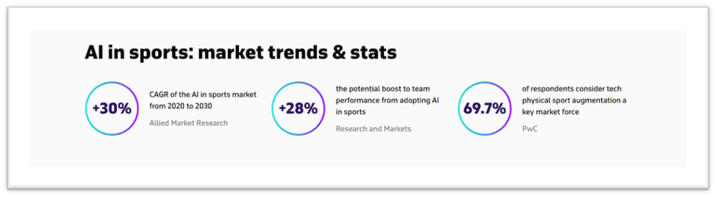
AI in sports can be used to identify patterns and trends with the help of data analysis.
The information gathered from data sports coaches and officials to determine the whereabouts of every place on the scale of fitness and performance.
This results in strategic decision-making and improved preparation.

Slide 3

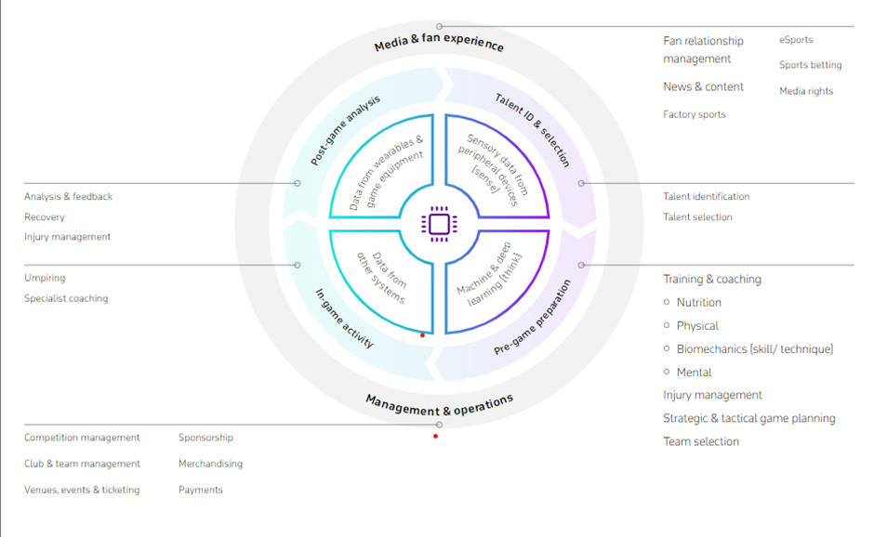


Slide 4


Role of AI in Sports Healthcare
The analytical and predictive capabilities of AI also find application in medical diagnostics, and health is a fundamental factor in determining the performance and well-being of athletes.
AI-powered systems can screen physiological and biochemical parameters, such as blood pressure or limb symmetry, to assess a player’s condition, spot any injuries or health problems, and select suitable therapies for faster recovery.
Collecting information through various sensors is essential for such analyses.
The absolute protagonists in this regard are health wearables thanks to their portability and increasingly low costs, which make them more and more popular not only among professional athletes but also amateurs.

Slide 5
AI Enabled Fracture Injury Detection in Athletes
The aim of this project is to develop an AI model capable of accurately identifying and classifying physiological injuries in athletes by analyzing X-ray.
This model will leverage machine learning and computer vision techniques to assist medical professionals in efficiently diagnosing injuries such as fractures, sprains, tears, and other musculoskeletal issues that commonly affect athletes.

Slide 6


Timeline of Bone Fracture Identification AI Model
Data Collection
Data Processing
Model Development
Model Evaluation
Gather a comprehensive dataset of X-ray and MRI scans of athletes with various types of injuries. This dataset should cover a wide range of injuries and be properly labeled for supervised learning.
Clean and preprocess the collected dataset, ensuring standardization, anonymization, and normalization of the images. This step involves resizing, grayscale conversion, and other necessary image processing techniques
1.Implement and train a deep learning model using convolutional neural networks (CNNs) for image analysis. Utilize transfer learning from pre-trained models like VGG, ResNet, or EfficientNet to expedite the training process.
1.Evaluate the developed model using appropriate metrics such as accuracy, precision, recall, and F1 score. Validate the model’s performance using a separate test dataset to ensure its generalizability.

Slide 7
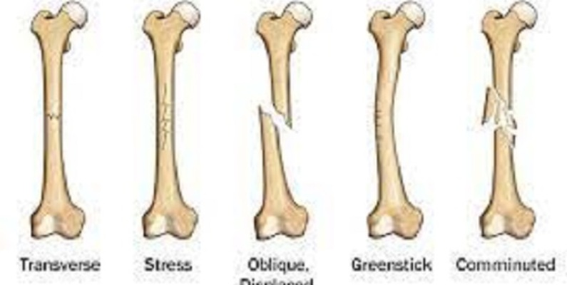
Data Collection
Dataset: Bone fracture detection using X rays
This dataset comprises of fractured and non-fractured x-ray images of several joints.
The task is to build an image classifier to detect fractures in a given x-ray image.
This dataset comprises of different joints in the upper extremities, isolation of individual joints is recommended for enhanced performance of classifiers.

Slide 8

Model
The model will contain the following components:
Importing necessary libraries,
Data processing,
Building the CNN Model,
Training the model,
Model Evaluation
Saving,
Deployment(Building a FastAPI backend server)

Slide 9
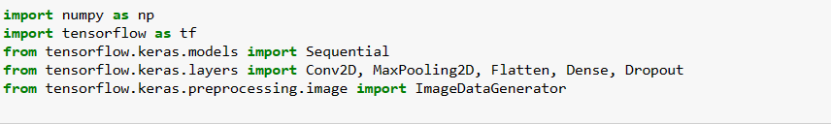


Required Libraries

Slide 10
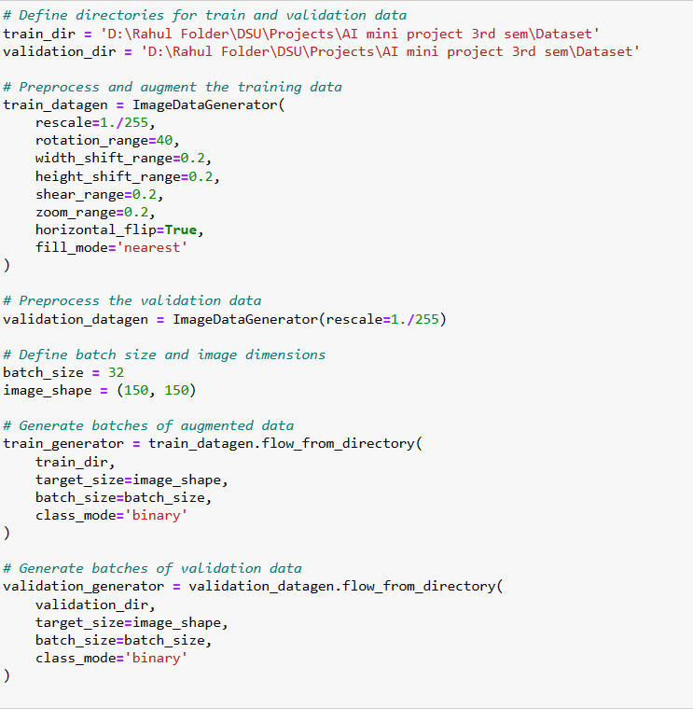
Data processing

Slide 11
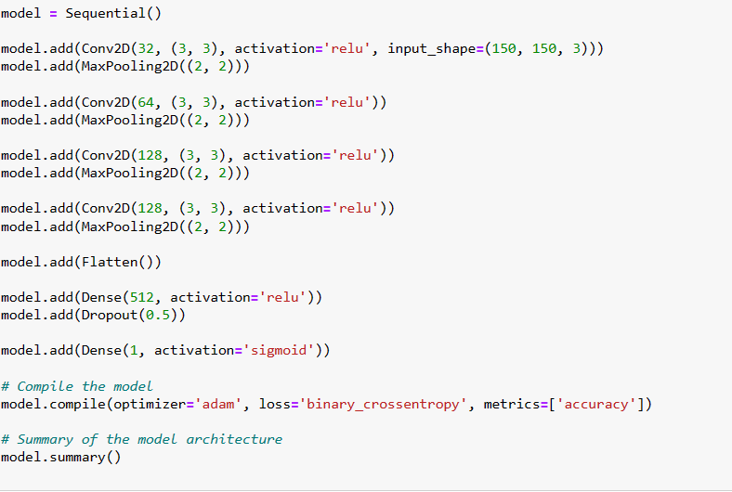
Building a CNN model

Slide 12
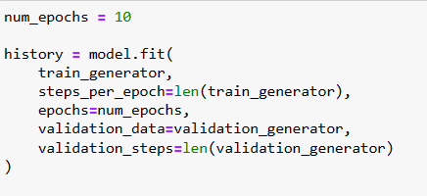
Training the model

Slide 13

Evaluation

Slide 14
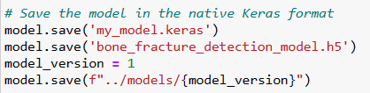
Saving the model

Slide 15
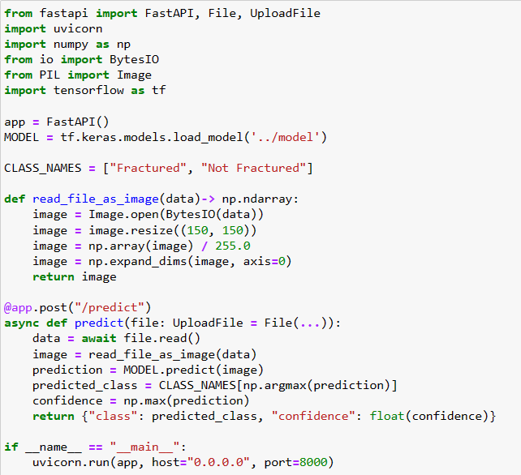

Building a FastAPI for deployment

Slide 16
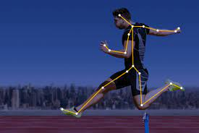
Issues faced while creating such a project
Data quality and Bias,
Interpretability,
Ethical concerns,
Technical challenges,
Regulatory Approval

Slide 17
Conclusion
The development of an AI model capable of accurately detecting physiological injuries in athletes through X-ray and MRI scans has the potential to revolutionize sports medicine by providing timely and accurate diagnoses.
This project's success could significantly aid medical professionals in expediting injury assessment and guiding appropriate treatment plans, ultimately contributing to athletes' health and performance.

Slide 18


GitHub: https://github.com/anonymus-code/fracture_detection
Dataset: https://www.kaggle.com/datasets/vuppalaadithyasairam/bone-fracture-detection-using-xrays
A project by:
Poojitha R (ENG22AM0160) : www.linkedin.com/in/poojitha-ramesh-4285a0296
Rahul V (ENG22AM0189): www.linkedin.com/in/rahul-v-759272294
R Chetanaananda (ENG22AM0188): www.linkedin.com/in/chetanaananda-r-91a7782a7
Arko Chakraborty (ENG22AM0147): www.linkedin.com/in/arko-chakraborty-69aa6a257

Slide 19
Thank You!
Building a Smarter Healthcare System with our Bone Fracture Identification AI Model.

